Slide 1
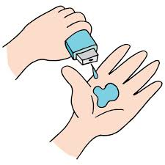
Doctors Visits
Mudgolwad Ravi,
STU65904a134363a1703954963,
JNTUH COLLEGE OF ENGINEERING SULTANPUR,
Computer Science and Engineering, CSE(AI & ML).

Slide 2

PROBLEM STATEMENT
This dataset provides insights into healthcare utilization, with factors such as doctor visit frequency, age, income, health status, insurance type, and chronic illness presence. Potential analysis goals include predicting doctor visit frequency, understanding healthcare access disparities, and assessing the impact of socioeconomic factors and chronic conditions on health outcomes. These insights can support better healthcare planning and resource allocation for diverse population groups.

Slide 3
Project Description
This project aims to analyze healthcare utilization patterns by examining doctor visit frequency alongside factors like age, income, health status, insurance coverage, and chronic illness presence. Through predictive modeling and statistical analysis, it will explore how socioeconomic and health-related variables influence healthcare demand. The results will provide valuable insights for improving healthcare access, policy planning, and resource allocation across different demographics.

Slide 4

WHO ARE THE END USERS?
End users for this project include:
1. Healthcare Providers: To anticipate patient demand and optimize resource allocation.
2. Policy Makers: To design policies that improve healthcare access and address disparities.
3. Insurance Companies: For insights into coverage needs and healthcare cost predictions.
4. Public Health Researchers: To analyze health trends and develop interventions for chronic conditions and preventive care.

Slide 5

Technology Used
  For this project I have used python programming language and the tools used are mentioned below.
  Pandas (library of python used for working with data frame)
  Matplotlib (library of python used to visualize represent data )
  Seaborn(Extending version for Matplotlib)
  Numpy(for numerics)
  I used VS CODE IDE for implementing project.
  For visual representation of data Julius AI | Your AI Data Analyst is also been involved in this project.

Slide 6
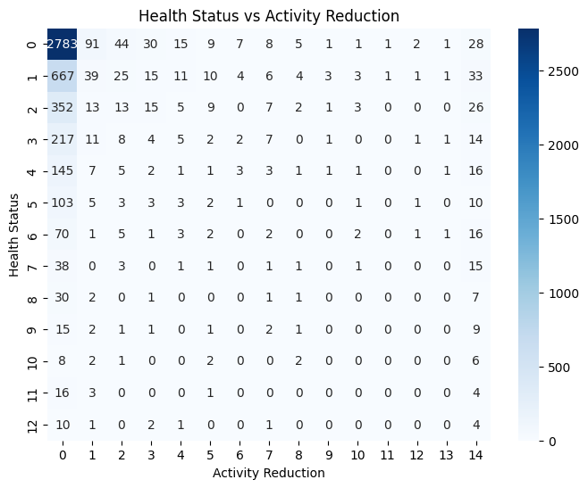
RESULTS
Here, are certainly 3 outputs from the project
The first result visualizes the relationship between health status and days of reduced activity due to health issues.
The heatmap reveals patterns showing how different health levels are associated with varying levels of activity reduction.
Demo Link

Slide 7
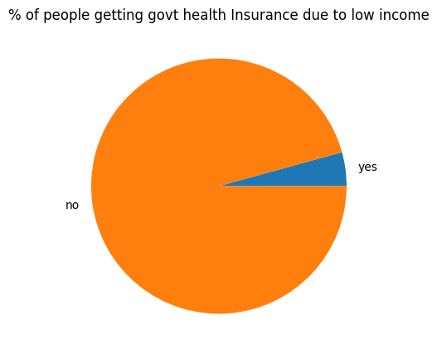
RESULTS
II.This pie chart showing the percentage of people who qualify for government health insurance due to low income.
It compares individuals with and without this benefit to highlight the distribution within the dataset.
Demo Link

Slide 8
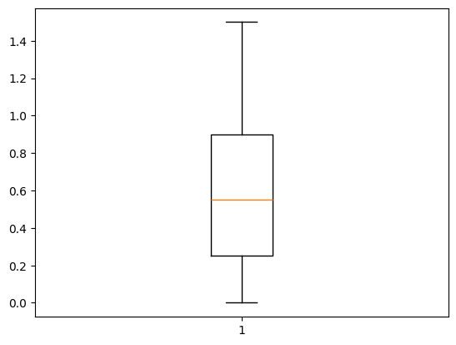
RESULTS
III. This is a box plot to display the distribution of income levels in the dataset. It helps identify income spread, central tendency, and potential outliers.
It show the income high , medium and low.
Demo Link

Slide 9
Thank you
.
.

